Slide 1
Scientific article reading and writing (Galactica)
Ross Taylor, Marcin Kardas, Guillem Cucurull, Thomas Scialom, Anthony Hartshorn, Elvis Saravia, Andrew Poulton, Viktor Kerkez, Robert Stojnic

Slide 2
Introduction
What is corpus?
Corpus refers to all the writings or works of a particular kind or on a particular subject, especially the complete works of an author.

Slide 3
Introduction
What is large language model?
A large language model (LLM) is a type of artificial intelligence that has been trained on vast amounts of text to understand existing content and generate original content.
Usage:
Speech Recognition
Machine language translation
Information Retrieval

Slide 4
Problem
Explosive growth in scientific literature and data
Hard to discover useful insight in large mass of information
Current Search engines unable to organize scientific knowledge alone

Slide 5
Solution
Galactica
Large language model for science
Interface for accessing and organizing scientific knowledge
Store, combine, and reason about scientific knowledge
Generating secondary content like literature reviews, lecture notes, and encyclopedia articles
Organize different modalities

Slide 6
Pros
Outperform existing models on a range of scientific tasks
On technical knowledge probes such as LaTeX equations (GPT-3)
On reasoning (Chinchilla & PaLM 540B)
On general corpus (BLOOM and OPT-175B)

Slide 7
Cons
Corpus Limitations : open-access resource only
Dataset: Scope Scientific only

Slide 8
Unlocked problem
New Objective Function
Verification
Continual learning

Slide 9

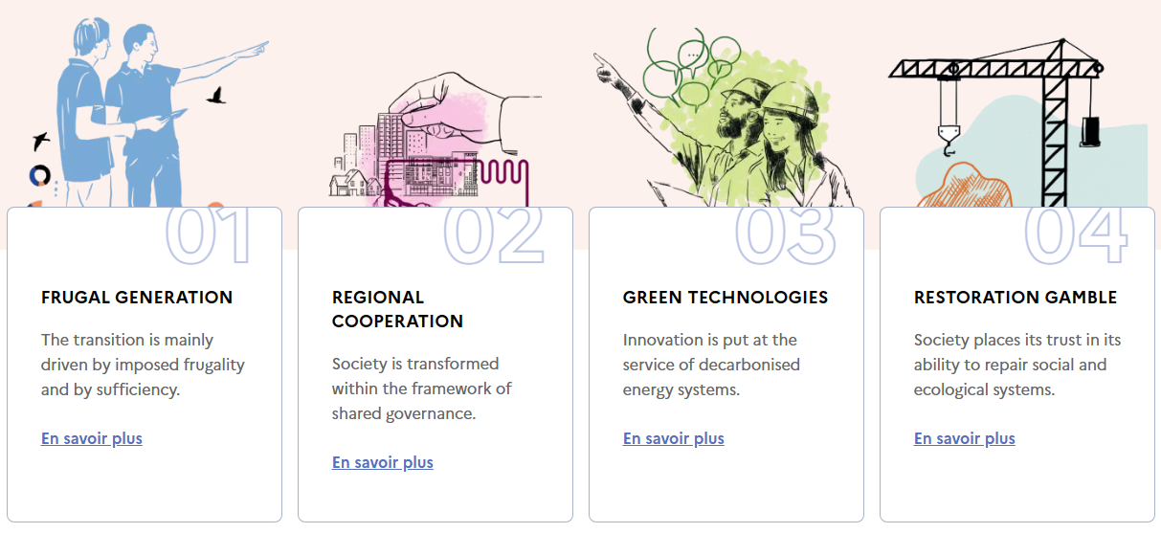
Ademe Scenarios
01 Frugal generation | 02 Regional cooperation
03 Green technologies | 04 Restoration gamble

Slide 10
Ademe Scenarios
Green technologies
To decrease the time consumption for searching the research material
Helping to produce secondary content like literature reviews, lecture notes, and encyclopedia articles

